Slide 1
Employee Data Analysis using Excel
STUDENT NAME: Venu Gopal R
REGISTER NO: E22CM069
DEPARTMENT: BCOM(General )
COLLEGE: PATRICIAN COLLEGE OF ARTS SCIENCE

Slide 3
PROJECT TITLE
Employee Performance Analysis using Excel

Slide 4


AGENDA
Problem Statement
Project Overview
End Users
Our Solution and Proposition
Dataset Description
Modelling Approach
Results and Discussion
Conclusion
3/21/2024 Annual Review

Slide 5

PROBLEM STATEMENT
Data Collection: Gathering relevant information such as performance metrics, attendance records, feedback surveys, and demographic details.
Data Cleaning and Preparation: Ensuring data accuracy and consistency by removing errors, duplicates, and irrelevant information.
Data Analysis: Using statistical methods, visualization tools, and analytical techniques to uncover patterns, trends, correlations, and anomalies within the data.
Interpretation and Insight Generation: Drawing conclusions and actionable insights from the analyzed data to support decision-making, improve HR practices, and optimize workforce management strategies.
Application: Implementing findings to enhance employee engagement, productivity, retention, and overall organizational performance.

Slide 6

PROJECT OVERVIEW
.
Collect and integrate employee data from various sources (e.g., HR systems, surveys, performance reviews)
- Clean, transform, and prepare data for analysis- Develop Excel dashboards and reports to visualize key metrics, including: - Demographics (age, tenure, department, etc.) - Performance ratings and trends

Slide 7

WHO ARE THE END USERS?
Informed Decision-Making:
Provides managers and executives with data-driven insights to make strategic decisions about promotions, resource allocation, and organizational improvements.
2. Targeted Training and Development:
Identifies specific skill gaps and areas for improvement, allowing HR and training teams to create effective, targeted training programs.
3. Enhanced Employee Engagement:
Offers employees clear feedback on their performance, which boosts motivation, engagement, and alignment with the organization’s goals.
4. Optimized Compensation and Rewards:
Ensures that compensation strategies are fair and performance-based, helping to retain high performers and motivate the workforce.
5. Organizational Improvement and Growth:
Supports continuous improvement by identifying areas where the organization can invest in development and drive overall growth.

Slide 8
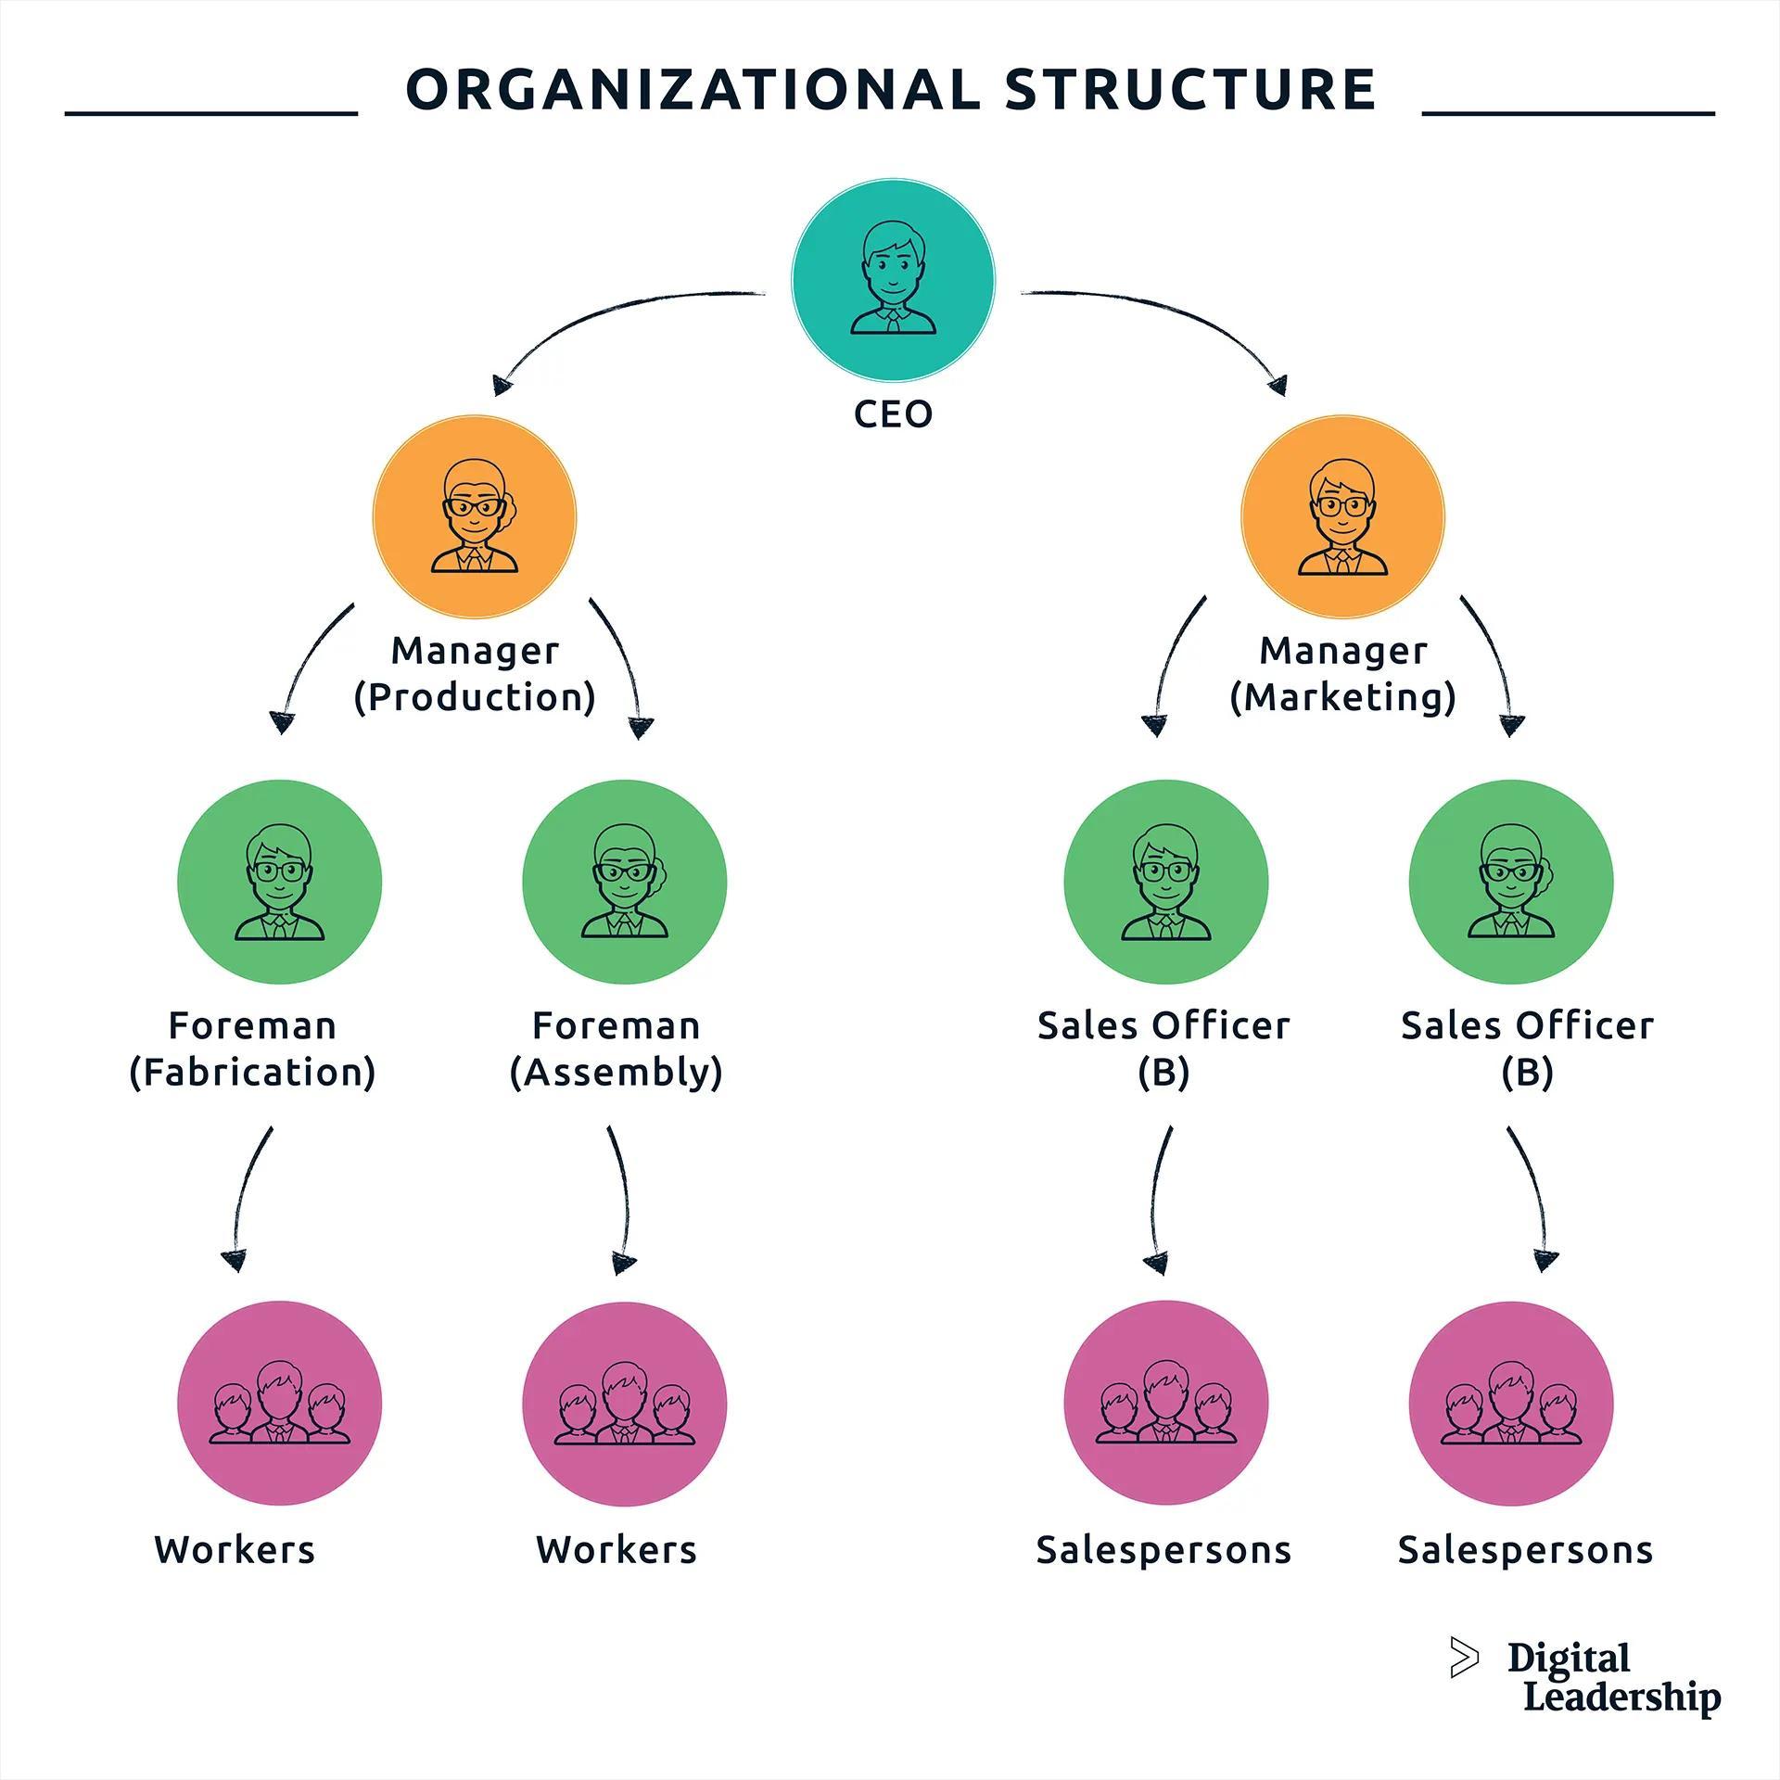

Slide 9

OUR SOLUTION AND ITS VALUE PROPOSITION
Conditional formatting = missing the values
1.Use Conditional Formatting to highlight blank cells in a dataset, applying a custom format (e.g., red fill) to cells containing missing values (=Is blank(A1)). Select the range, go to Home > Conditional Formatting > New Rule > Use a formula to determine which cells to format. Enter the formula =ISBLANK(A1) and set the desired format.
Filter = remove the missing
Filter: Data > Filter > Blanks.2. Go To Special: Ctrl + G > Special > Blanks.3. Conditional Formatting: Home > Highlight Cells Rules > Blank Cells.
Formula of perform analysis
syntax
Syntax:- logical_test1, logical_test2, ...: Conditions to evaluate- value_if_true1, value_if_true2, ...: Values to return if conditions are true

Slide 10
Formula = checking for performance
=IFS(A1>10000, "High", A1>5000, "Medium", "Low")These formulas categorize data in cells A1, B1, and C1 based on specified conditions, returning corresponding values ("High", "Medium", "Low", etc.). Use these formulas to analyze and classify your data, and make informed decisions!
Pivot table
1. Select the data range you want to summarize.2. Go to the "Insert" tab and click on "PivotTable".3. Drag the field you want to summarize (e.g., "Sports") to the "Row Labels" area.4. Drag the field you want to summarize (e.g., "Total Number Students") to the "Values" area.5. Right-click on the "Values" field and select "Summarize" > "Summarize by" > "Average" (or any other summary function you need).6. To show only the top 3 lines, right-click on the "Row Labels" field and select "Filter" > "Top" > "Top 3".

Slide 11
Graph
Step 1: Select Data Choose the data range you want to graph, including headers. Go to the "Insert" tab in the ribbon.
Step 2: Choose Graph Type- Click on the graph type you want to create (e.g., Column, Line, Pie, Bar).- Select a subtype (e.g., 2D or 3D).
Step 3: Customize Graph- Right-click on the graph to access formatting options.- Adjust elements like titles, labels, colors, and fonts.
Step 4: Add Data Labels- Right-click on the graph and select "Add Data Labels".- Choose where to display labels (e.g., above, below, or inside data points).
Step 5: Finalize- Review and adjust your graph as needed.- Save your workbook.

Slide 12
Dataset Description
Employee ID (unique identifier)
Name( First name ,last name)
Department
Job Title
5. Hire Date
6. Performance Ratings (e.g., 1-5 scale, low to very high)
7. Gender

Slide 13

THE "WOW" IN OUR SOLUTION
Performance analysis formula
=IFS(G5>=5,"VERY HIGH",G5>=4,"HEIGH",G5>=3,"MED",TRUE,"LOW")
3/21/2024 Annual Review
12

Slide 14
MODELLING
Data collection *
Step 1: Define the Problem and Objectives- Identify the goals of the analysis (e.g., employee turnover, performance, engagement)- Determine the key questions to answer
Step 2: Choose a Dataset- Search for relevant employee datasets on Kaggle (e.g., HR Analytics, Employee Attrition)- Select a dataset that aligns with your objectives
13

Slide 15
Step 3: Import and Explore the Data- Import the dataset into a Kaggle notebook or Excel- Explore the data using summary statistics, visualizations, and data profiling
Feature collection
- HR systems (e.g., Workday, BambooHR)- Performance management tools (e.g., Lattice, 15Five)- Employee engagement surveys (e.g., Culture Amp, SurveyMonkey)- Time-off and attendance systems (e.g., ADP, Namely)- Training and development platforms (e.g., Udemy, LinkedIn Learning)

Slide 16
Data cleaning
Remove irrelevant data
Eliminate columns or rows unrelated to performance analysis.
Handle missing values
Decide on a strategy for missing performance ratings, feedback, or other relevant data.

Slide 17
Performance level
Step 1: Prepare Your Data Collect and import relevant data, such as employee performance ratings, goals, and feedback Ensure data is organized and formatted consistently
Step 2: Categorize Performance Levels- Define performance levels (e.g., Excellent, Meets Expectations, Needs Improvement)- Assign numerical values or codes to each level
Step 3: Calculate Performance Scores- Use formulas to calculate performance scores based on ratings, goals, and feedback- Consider using weighted averages or indexes to combine multiple metrics

Slide 18
Step 4: Identify High and Low Performers- Set thresholds for high and low performers based on performance scores- Use conditional formatting or filtering to highlight high and low performers
Pivot summary
1. Data Aggregation: Summarize data by sum, average, count, or other functions.
2. Data Rotation: Rotate data to view different perspectives (e.g., switch rows and columns).

Slide 19
3. Customization: Create personalized summaries by selecting specific fields and filters.
4. Drill-Down Capability: Double-click to view detailed data behind summary values.

Slide 20
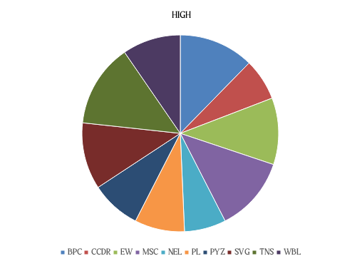
RESULTS
19

Slide 21
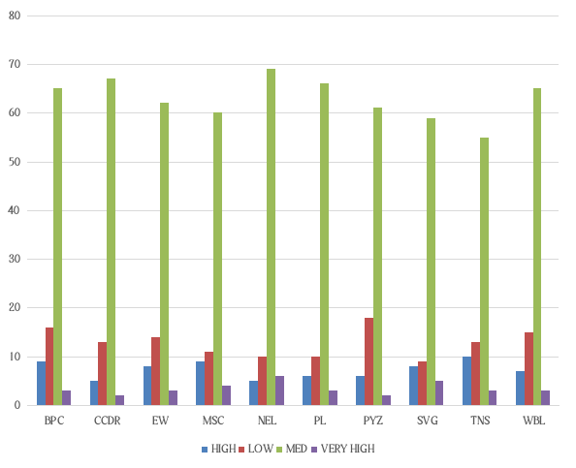

Slide 22
conclusion
- "Data analysis is not just about numbers, it's about telling a story that drives action and improves employee lives."

